Slide 1

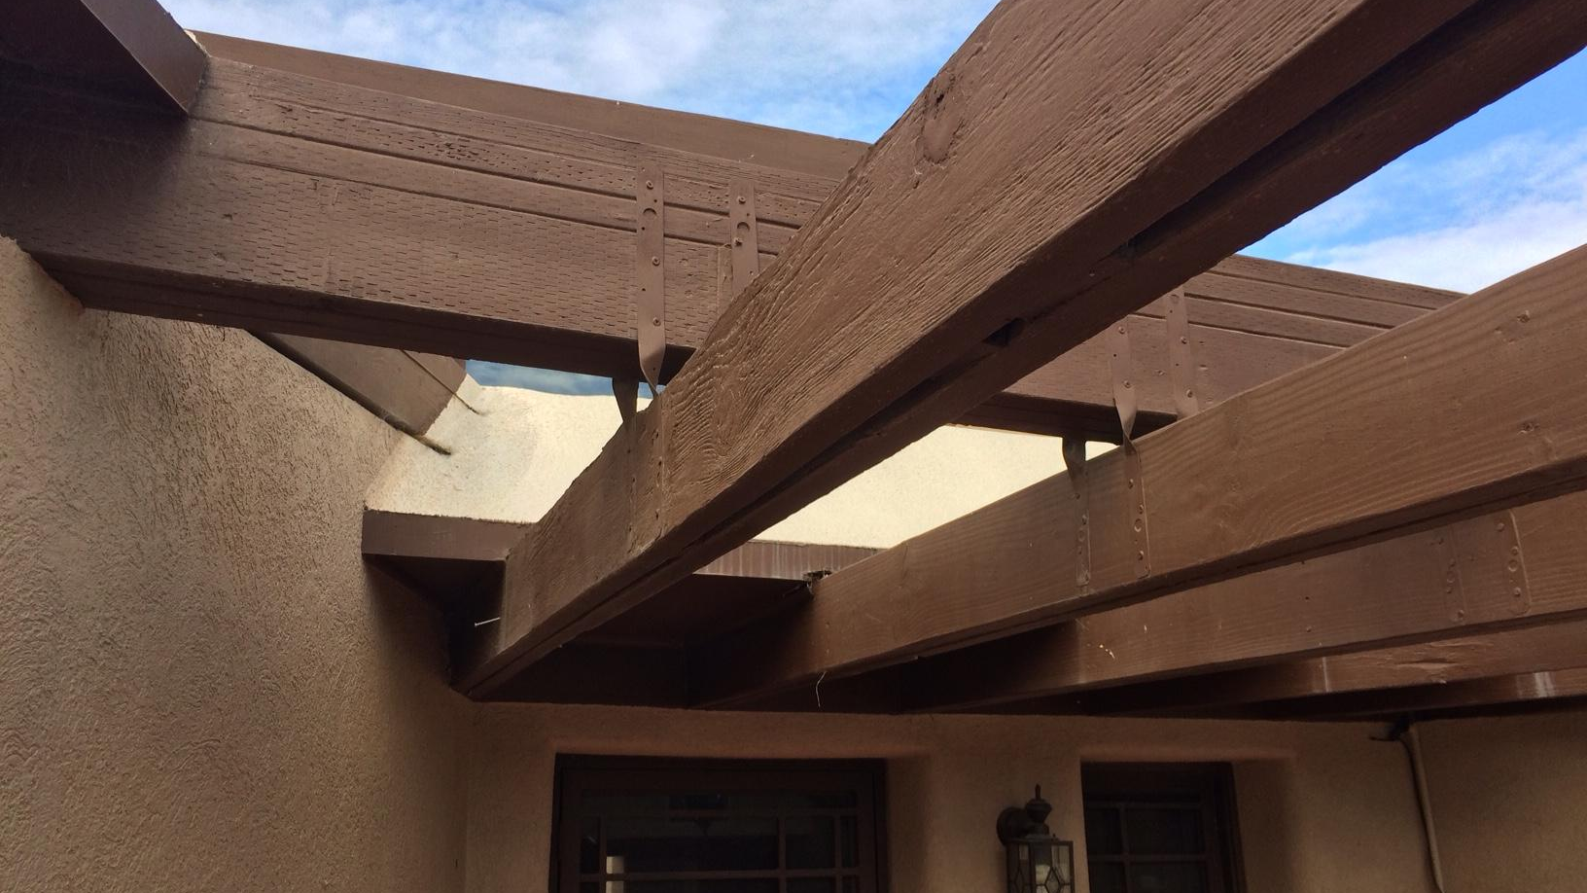
Deflection and Bending
of Cantilever Beam
This Photo by Unknown author is licensed under CC BY-SA.

Slide 2

Basic Introduction
Cantilever beams are structural elements that extend horizontally from a supporting structure and are only fixed at one end. They are commonly used in construction, such as building overhangs, balconies, and bridge decks. Cantilever beams are subjected to various loads, including point loads, distributed loads, and moments. These loads cause the beam to deflect and bend, which can lead to structural failure if not properly designed.
Deflection is the vertical displacement of a beam under load. It is typically measured at the free end of the cantilever beam. The deflection of a cantilever beam is directly proportional to the applied load and the length of the beam, and inversely proportional to the stiffness of the beam material and its cross-sectional dimensions.
Bending is the deformation of a beam under load that causes it to curve. Bending stress, which is the internal stress developed in the beam due to bending, is typically highest at the outermost fibers of the beam and decreases towards the neutral axis, the line that passes through the centroid of the cross-section and experiences no bending stress.
This Photo by Unknown author is licensed under CC BY-SA.

Slide 3


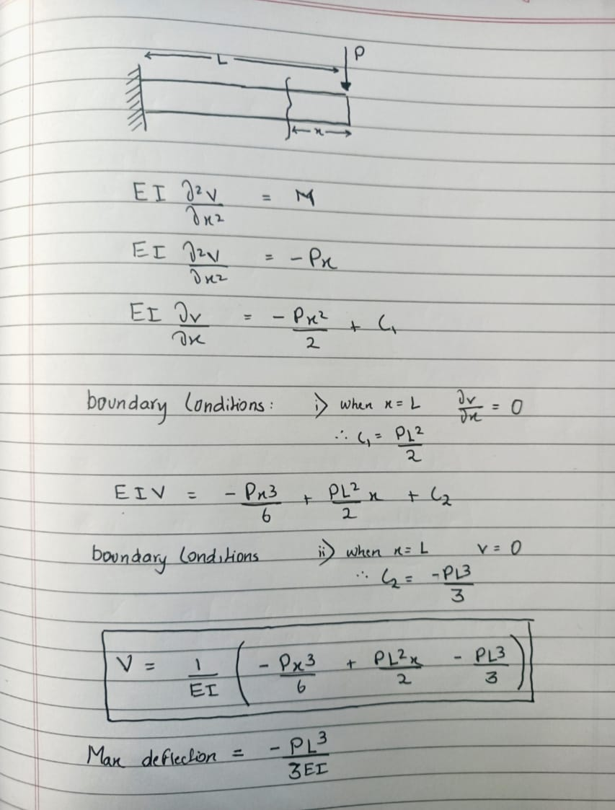
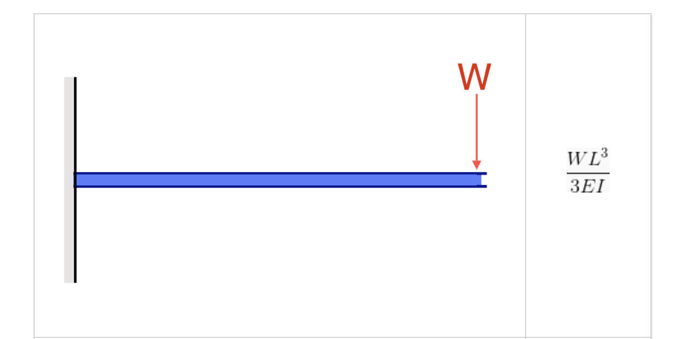
Formula
Cantilever Beam equations can be calculated from the following formula, where:
W = Load
L = Member Length
E = Young’s Modulus
I = the beam’s Moment of Inertia
V=1/EI(-Px^{3.0} /6 + PL²x/2 -Pl³/3)
Deflectionmax
-

Slide 4
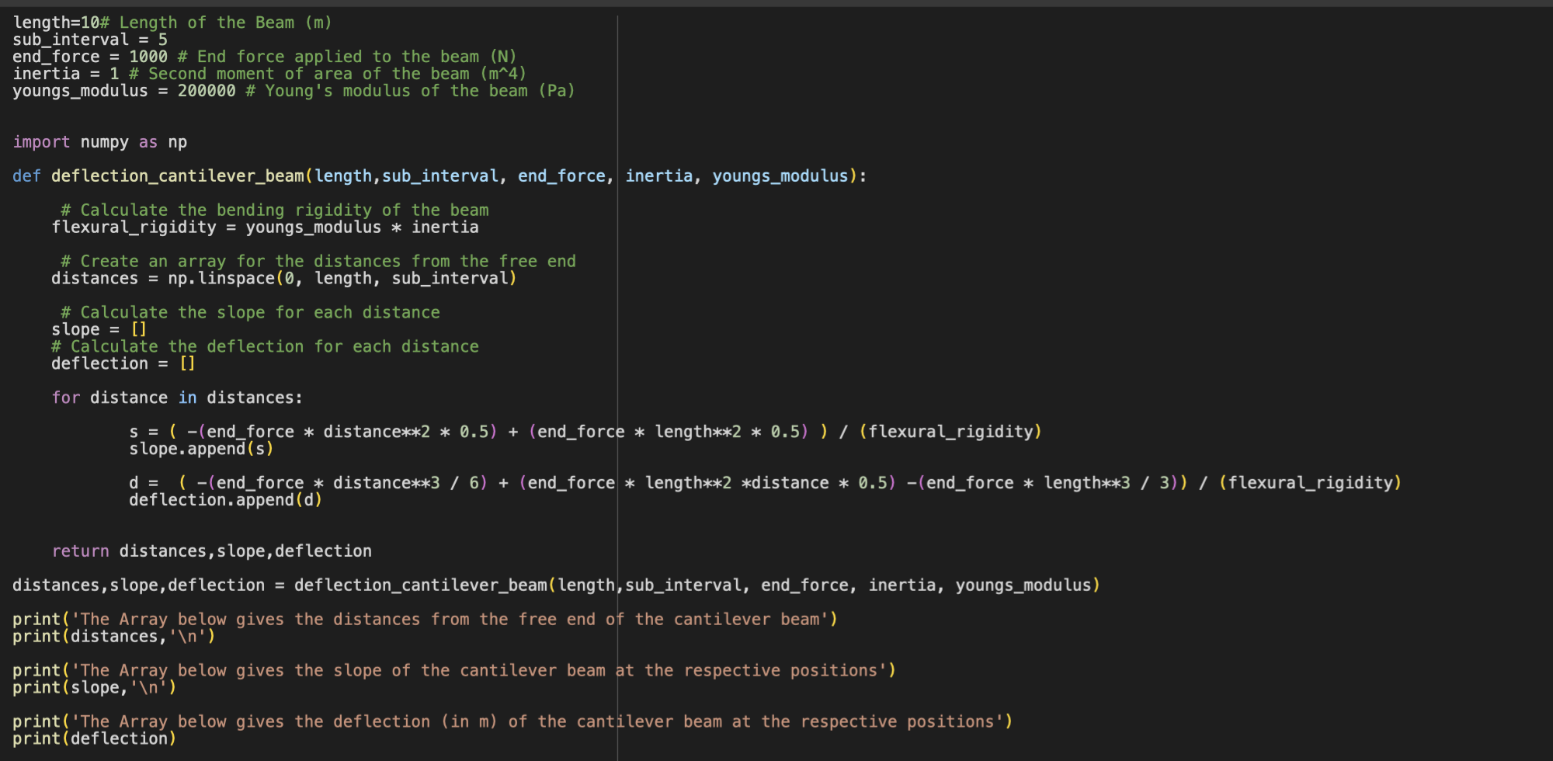
Code Involved
We did code in python programming language using some libraries- numpy, pandas, matplot.

Slide 5
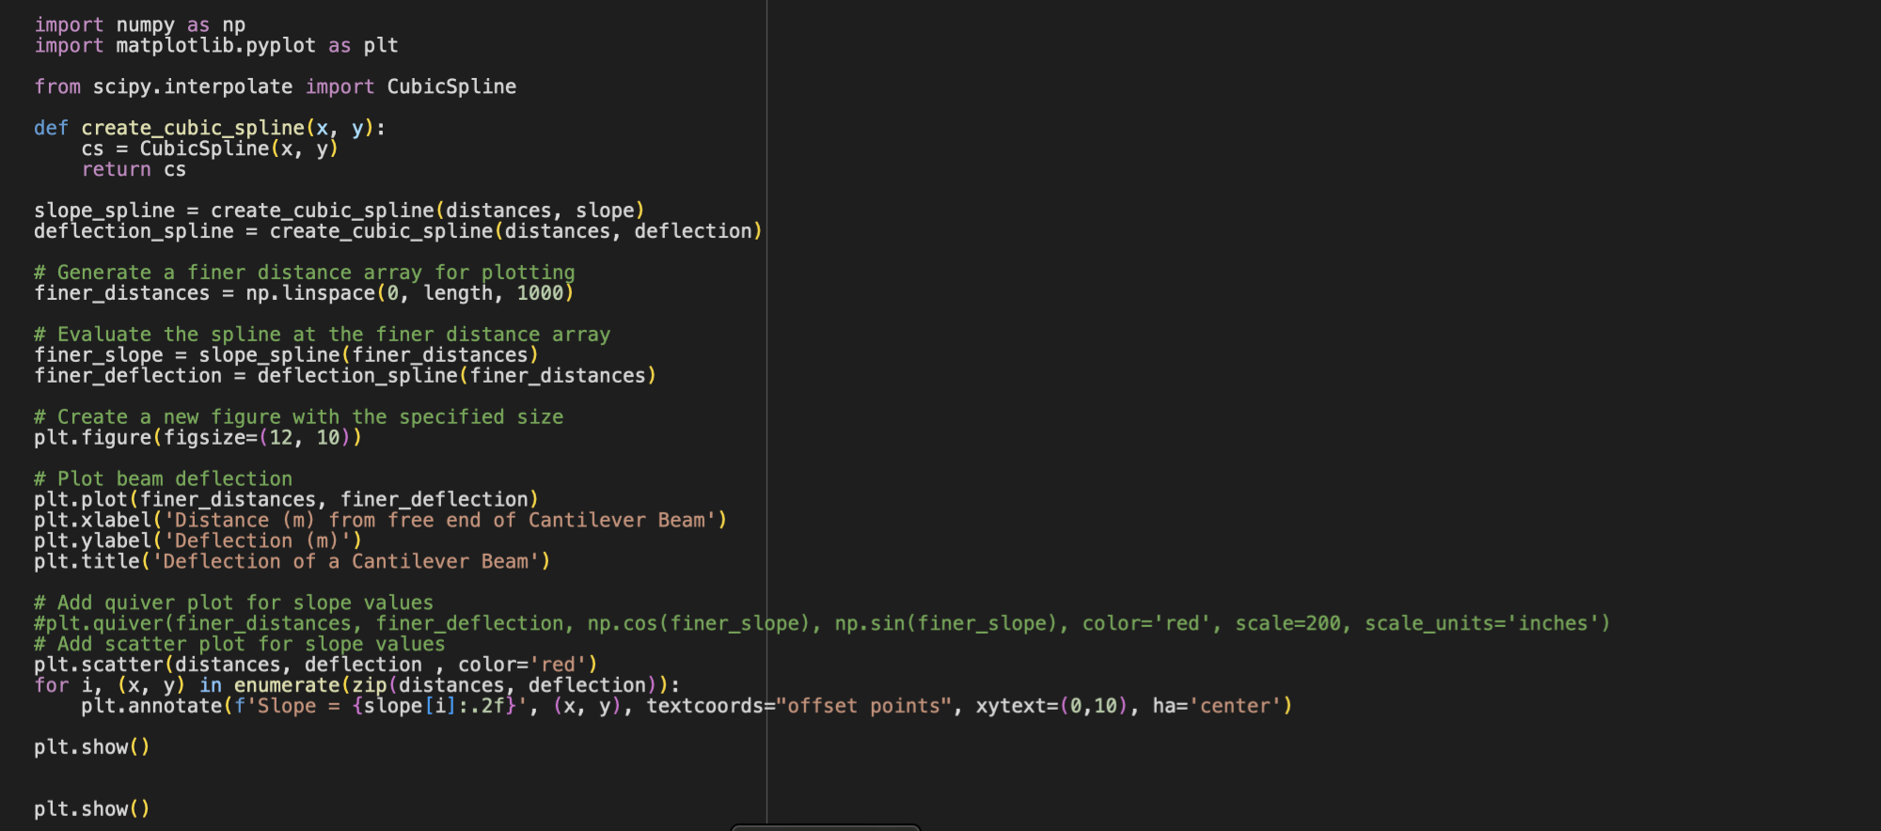
Code Part-2

Slide 6
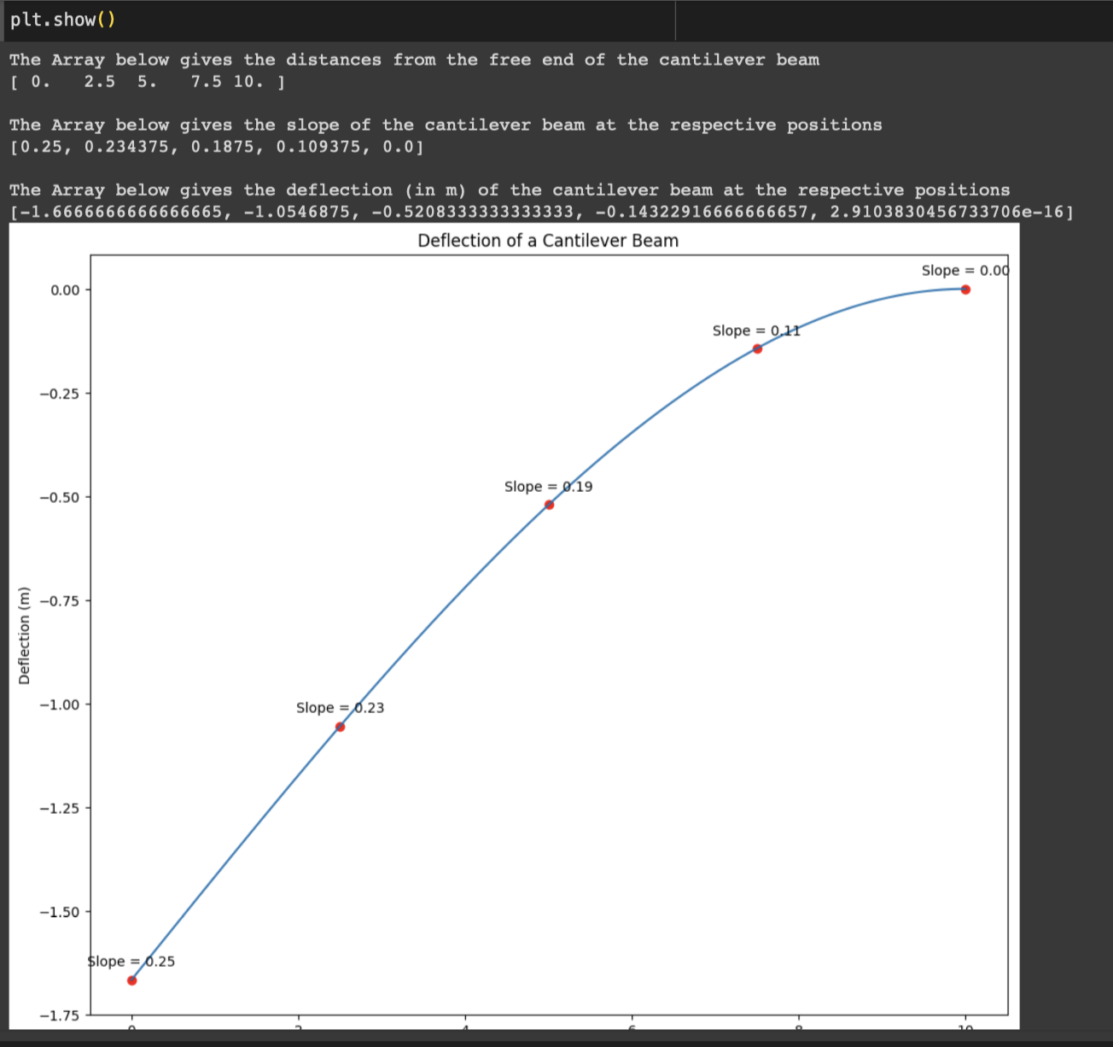
Output

Slide 7
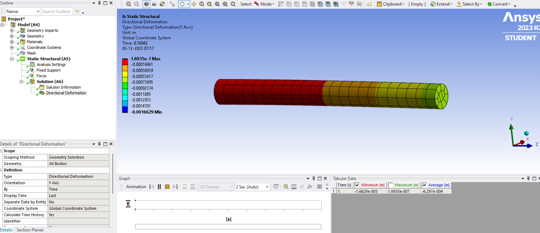
Visual Representation on Ansys

Slide 8
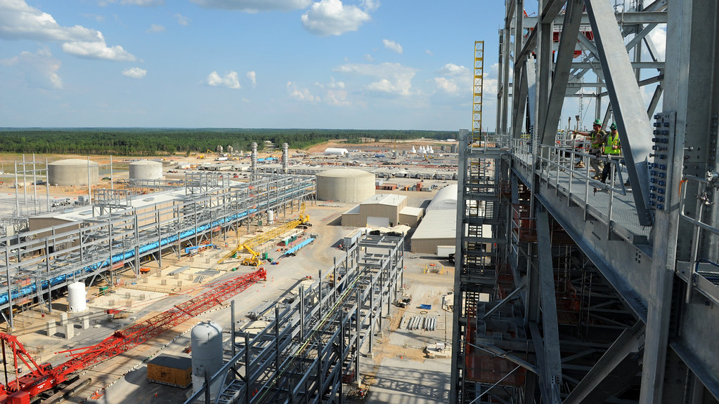
Application of Cantilever Beam
Cantilever beams are widely used in various engineering applications due to their ability to support loads without additional support beyond the fixed end. Common applications include:
Building Overhangs: Cantilever beams are often used to create overhangs in buildings, providing shade, protection from weather, and architectural aesthetics.
Balconies: Cantilever beams support balconies, extending the usable space of buildings without requiring additional columns or support structures.
Bridge Decks: Cantilever beams can be used in bridge construction, particularly for pedestrian bridges or short spans, providing support for the bridge deck while minimizing the number of piers required.
Crane Arms: Cantilever beams form the core of crane arms, enabling them to extend horizontally and lift loads without the need for additional support.
Aircraft Wings: Cantilever beams are the primary structural elements of aircraft wings, providing the necessary lift and support during flight.
Industrial Applications: Cantilever beams are frequently employed in industrial settings, supporting machinery, conveyor belts, and other equipment.
This Photo by Unknown author is licensed under CC BY-ND.

